Slide 1
405 BBLAB Summer Course
2023/07/26

Slide 2
Outline
Qt&Pack (hw1)
Master(Project)
Demo
UI/UX

Slide 3
405 BBLAB Undergraduate Course
2023/07/26

Slide 4
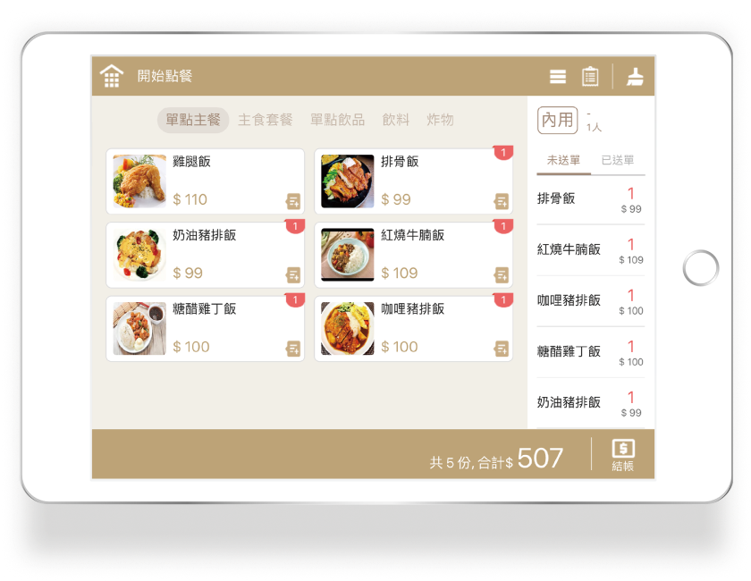
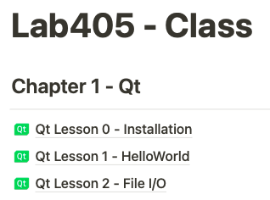
Qt – Ordering System
https://www.notion.so/wesleych3n/Lab405-Class-372cedcc18f547d09f5d0b64540da2cd
Source: https://ecpos.mybiz.net.tw/tablet/

Slide 5
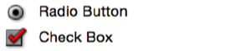
Function
Radio Button: single choice
Check Box: multiple choice
Push Button: click event (signal)
Text File: record user order and calculate price
Image File: add icon to beautify your ui

Slide 6
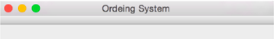
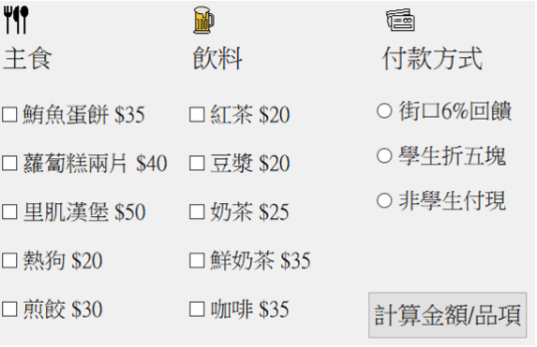
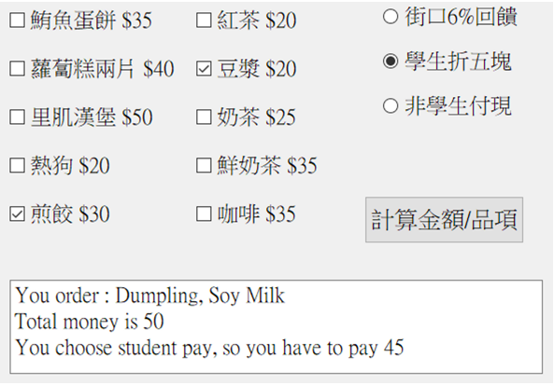
Example
Title
Image File (icon)
Check Box
Radio Button
Push Button
Text File

Slide 7
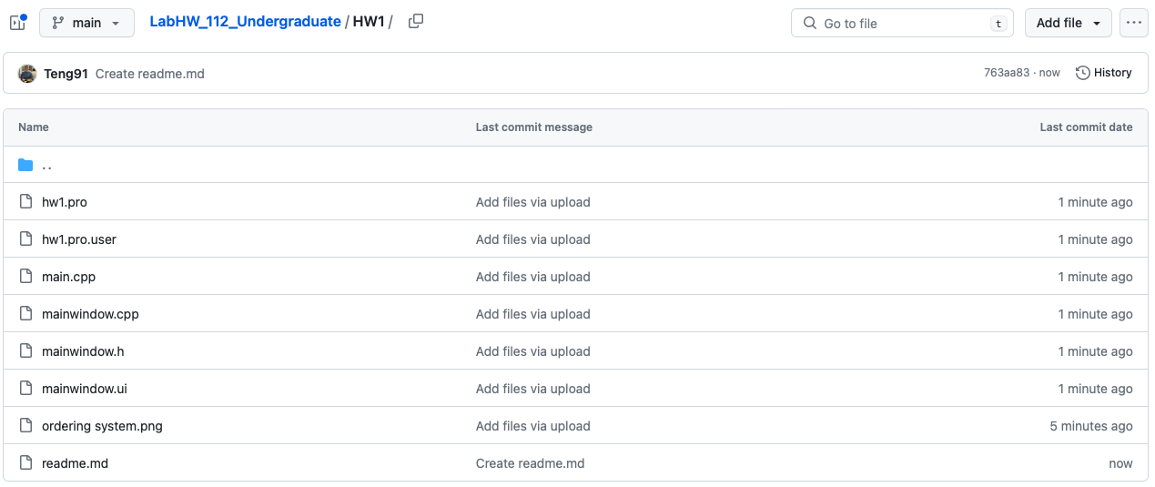
Sample Code
https://github.com/bblabNTU/LabHW_112_Undergraduate/tree/main/HW1

Slide 8
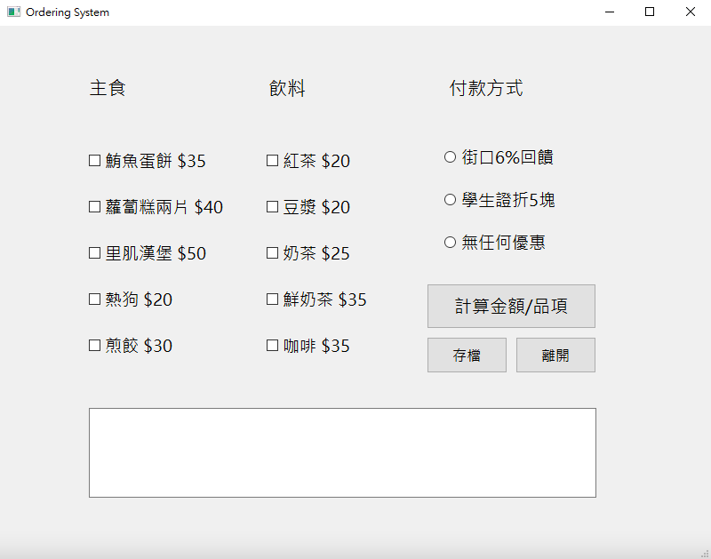
HW1
新增icon
存檔紀錄
打包exe

Slide 9
打包exe
Qt (Release) -> 發佈程式 -> 程式打包
EzDeploy
https://github.com/bblabNTU/LabHW_112_Undergraduate/tree/main/HW1/EzDeploy(Qt打包)/EzDeploy
Windeployqt + Enigma Virtual Box
https://blog.51cto.com/u_14114084/3652819

Slide 10
405 BBLAB Master Course
2023/07/26

Slide 11


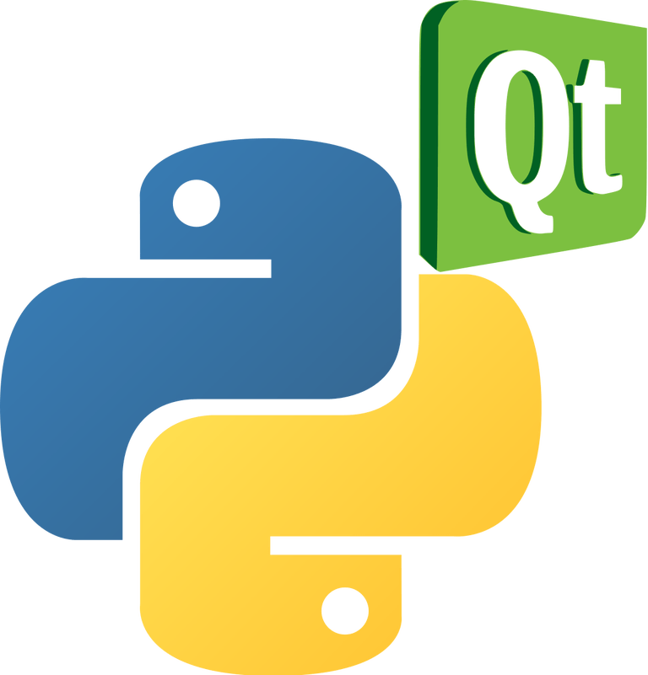




UI/UX
https://goodfangsm.life/product_details/64864895.html

Slide 12
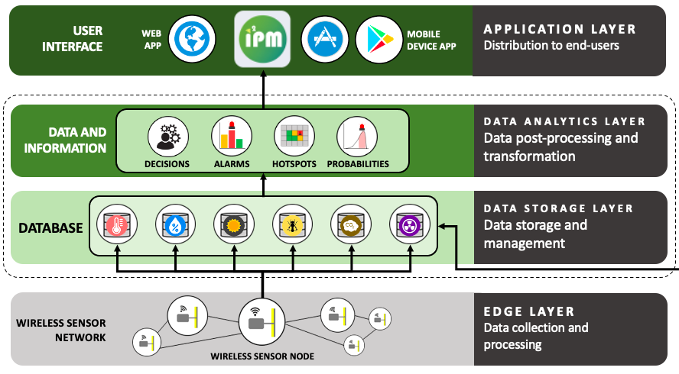
Example – Insect Pest Management (IPM)

Slide 13
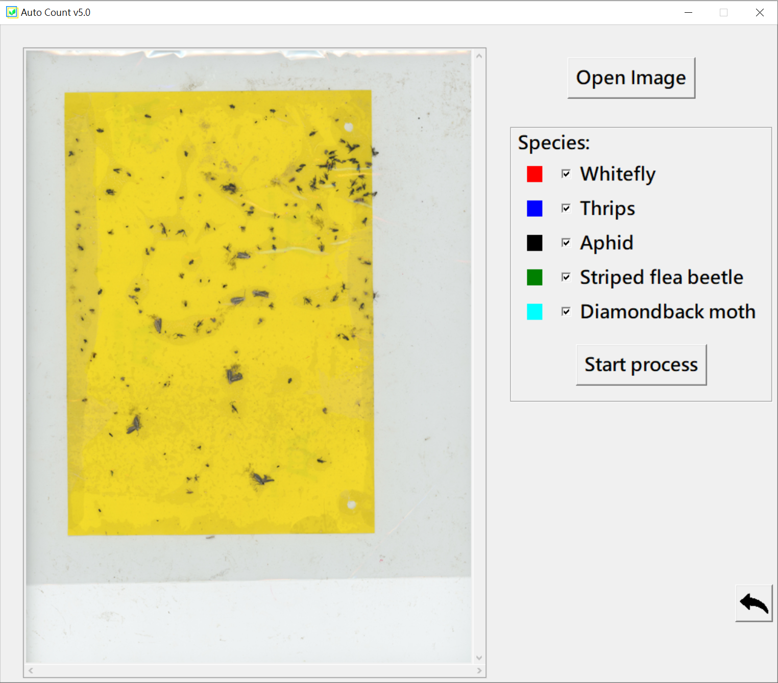


Project – Qt + load your model

Slide 14
Introduction of Project
Image Labeling
Train your own yolo model
Object Detection
Image Recognition
Establish environment of importing YOLO model
Convert model weights format
How to load model via OpenCV in Qt
Qt user interface design

Slide 15
Image Labeling
Labelimg windows_v1.8.0
Data > predefined_classes
No Chinese file path
Convert “PascalVOC” to “YOLO”
Open Dir -> Input image path
Change Save Dir -> Output txt path
Press “W” to select target area

Slide 16
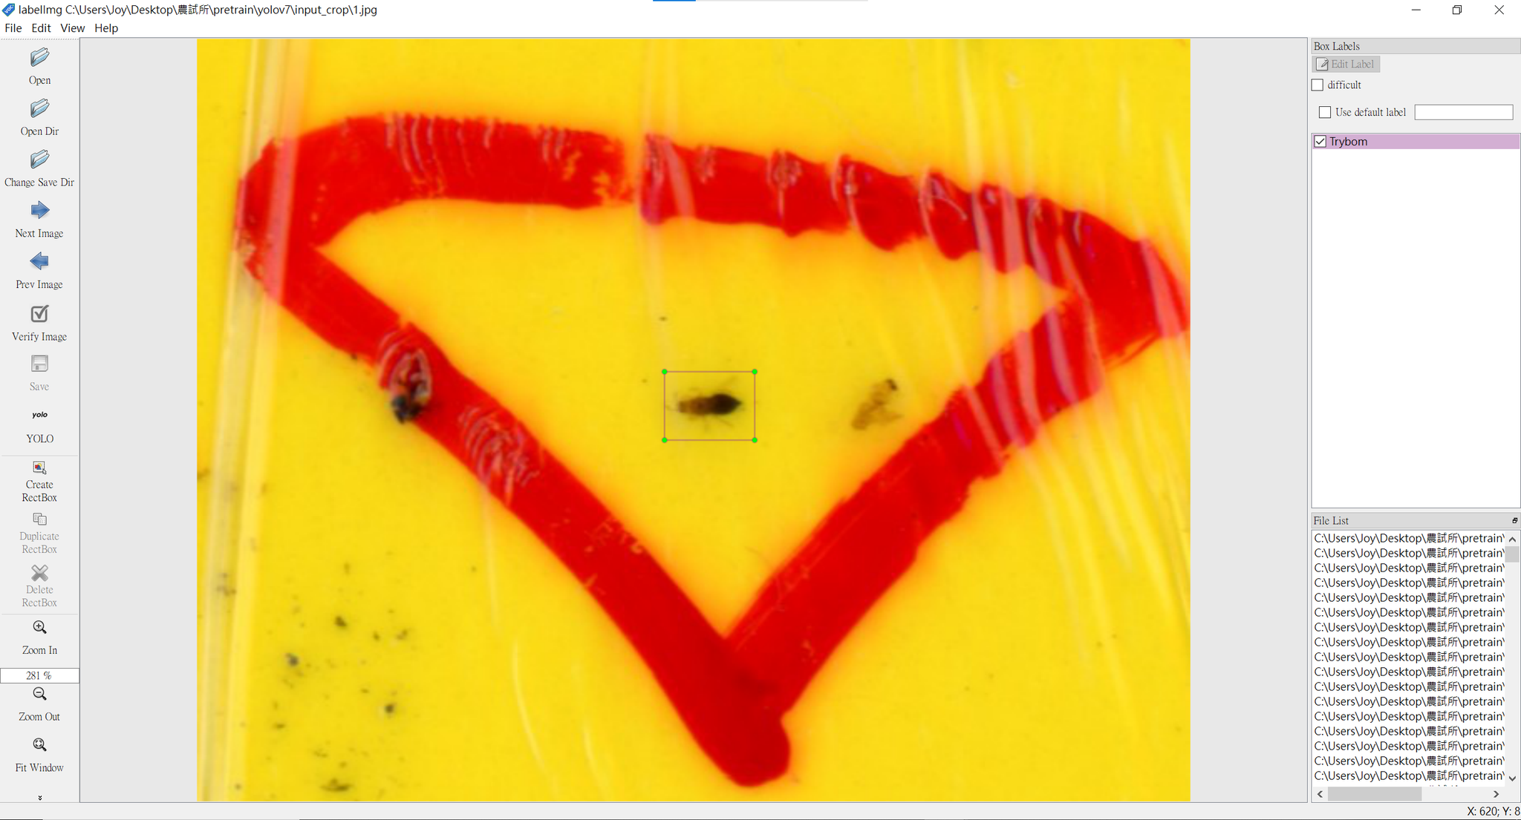
Image Labeling
0 0.515966 0.480306 0.090756 0.089716
class：類別 ID
x_center：中心點 X 座標
y_center：中心點 Y 座標
width：方框寬度
height：方框高度

Slide 17
Train YOLO model
You can use python to train your YOLO model
YOLOv7 video
https://www.youtube.com/watch?v=-QWxJ0j9EY8&t=60s
Detailed steps on my HackMD – YOLOv7
https://hackmd.io/@bhIA534oS4WfxIHxC2EFfA/rkyJcLL5h

Slide 18
Establish environment
windows安裝CUDA跟CUDNN
https://medium.com/ching-i/win10-%E5%AE%89%E8%A3%9D-cuda-cudnn-%E6%95%99%E5%AD%B8-c617b3b76deb
自己build OpenCV
https://machinelearningprojects.net/build-opencv-with-cuda-and-cudnn/?amp=1

Slide 19
Tips
CUDA, CUDNN跟CMake的版本對應
CUDA跟CUDNN的版本(CUDA>=10.0、CUDNN>=7.5)建議上網找別人成功的版本對應
沒有安裝Visual Studio或是沒有選擇到對應的版本(Win 11 SDK for VS 2022、Win 10 SDK for VS 2019)要確保有安裝Visual Studio Installer
安裝在本地端，而不是虛擬環境(PyCharm)

Slide 20
Check your environment
Set OpenCV path on Environment Variables
Modify CmakeList.txt
Import yolo.h and yolo.cpp on Github
Cmake and run sample code
Detailed steps on my HackMD – OpenCV Cmake
https://hackmd.io/@bhIA534oS4WfxIHxC2EFfA/r1WMd493j/%2Fh4pRL7I4SfeFroKbKJsaEg

Slide 21
Demo

Slide 22
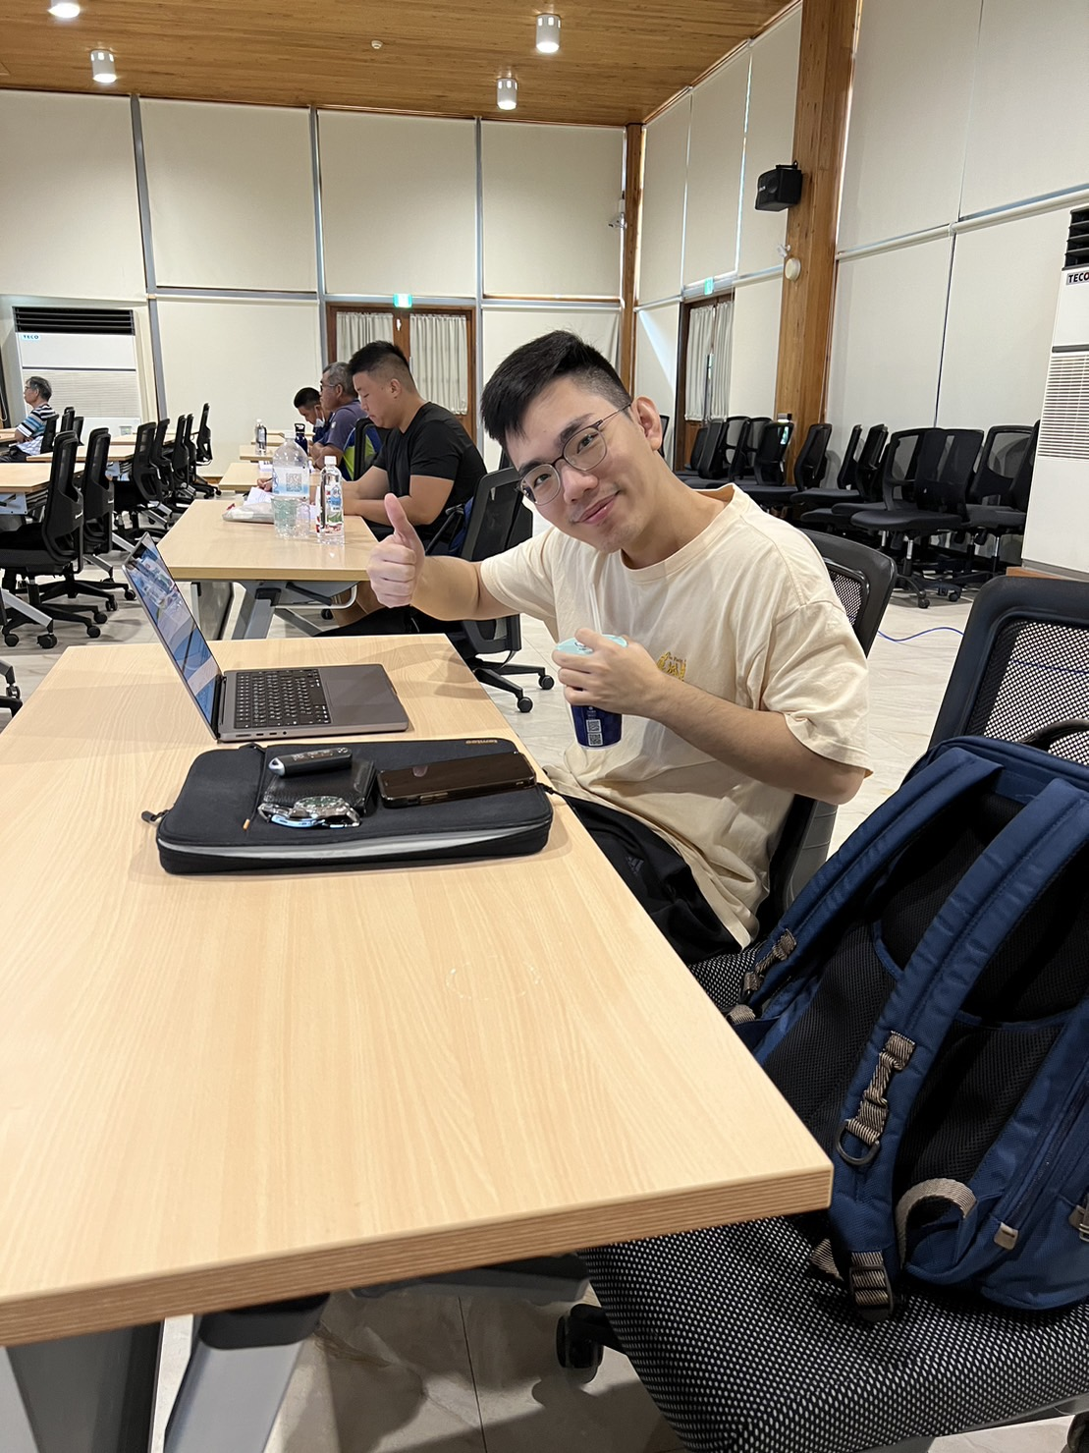
Next Week … Mr. Liao
Image Labeling
Train your own yolo model
Object Detection
Image Recognition
Establish environment of importing YOLO
Convert model weights format
How to load model via OpenCV in Qt
Qt user interface design

Slide 23
Thanks for listening

